Slide 1
Queries
The Hibernate object-oriented query facilities

Slide 2
Hibernate query options
The Hibernate Query Language (HQL):
The Criteria API for type-safe queries:
Direct SQL with Hibernate mapping:
session.createQuery("from Category cat where cat.name like '%Flights'").list();
session.createCriteria(Category.class)
.add( Expression.like("name", "%Flights") )
.list();
session.createSQLQuery(
"select {cat.*} from CATEGORY {cat} where NAME like '%Flights'",
"cat",
Category.class)
.list();

Slide 3

Executing queries
We execute queries with the
  Query object from createQuery() and createSQLQuery()
  Criteria object from createCriteria()
Pagination:
Getting a list or results, or a single result:
Iterating:
Query q = session.createQuery("from User user order by user.name asc")
.setFirstResult(30)
.setMaxResults(10)
.list();
List result = q.list();
Object o = q.setMaxResults(1).uniqueResult();
Iterator it = q.iterate();

Slide 4
Binding parameters
We should never use String manipulation:
We use named parameter binding:
String queryString = "from Item i where i.description like '" + string + "'";
List result = session.createQuery(queryString).list();
String queryString = "from Item item "
+ "where item.description like :searchString "
+ "and item.date > :minDate";
List result = session.createQuery(queryString)
.setString("searchString", searchString)
.setDate("minDate", minDate)
.list();

Slide 5
Externalizing named queries
We can execute a named query:
The query is defined in the mapping metadata:
We can also name SQL queries:
Query q = session.getNamedQuery("findItemsByDescription")
.setString("description", description);
<query name="findItemsByDescription"><![CDATA[
from Item item where item.description like :description
]]></query>
<sql-query name="findItemsByDescription"><![CDATA[
select {item.*} from item where description like :description
]]>
<return alias="item" class="Item"/>
</sql-query>

Slide 6

Basic queries in HQL and with Criteria
The simplest query:
Using an alias:
Polymorphic queries:
from Bid
session.createCriteria(Bid.class)
from Bid as bid
from BillingDetails
from CreditCard
from java.lang.Object // Returns all persistent objects!
session.createCriteria(BillingDetails.class)

Slide 7
Restriction
Restriction with a where clause in HQL:
Using a Criterion:
All regular SQL operators are supported in expressions:
from User user where user.email = 'foo@hibernate.org'
Criterion emailEq = Expression.eq("email", "foo@hibernate.org);
Criteria crit = session.createCriteria(User.class);
crit.add(emailEq);
User user = (User) crit.uniqueResult();
from User user where user.email = 'foo@hibernate.org'
and user.firstname like 'Max%'
and user.lastname is not null
or user.signupDate < :mondayLastWeek

Slide 8
String matching
We can use wildcards for string pattern matching:
The Criteria API allows string matching without string manipulation:
We can also call arbitrary SQL functions in the where clause:
from User user where user.firstname not like "%Foo B%"
session.createCriteria(User.class)
.add( Expression.like("firstname", "G", MatchMode.START) );
from User user where lower(user.email) = 'foo@hibernate.org'
session.createCriteria(User.class)
.add( Expression.eq("email", "foo@hibernate.org").ignoreCase() ) );

Slide 9
Ordering results
The order by clause is used in HQL:
The Criteria API also supports ordering of results:
HQL and the Criteria API give you all the power of SQL
without falling back to table and column names.
from User user order by user.username desc
from Item item
order by item.successfulBid.amount desc, item.id asc
List results = session.createCriteria(User.class)
.addOrder( Order.asc("lastname") )
.addOrder( Order.asc("firstname") )
.list();

Slide 10
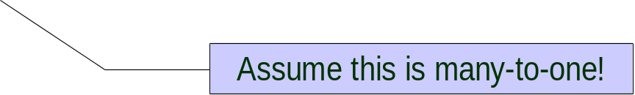
Using implicit association joins
We can query components (dereference with a dot):
We can join single-ended associations implicitly:
We have to be careful (how many SQL joins is this?):
from User user where user.address.city = 'Bangkok'
from Bid bid where bid.item.description like '%gc%'
from Bid bid where bid.item.category.name like 'Laptop%'
from Bid bid
where bid.item.category.name like 'Laptop%'
and bid.item.successfulBid.amount > 100

Slide 11
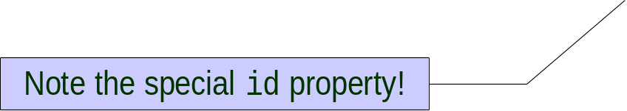
Aggregation in HQL
The aggregation functions are
  count(), min(), max(), sum() and avg()
Count all items with a successful bid:
The total of all successful bids:
The result is an ordered pair of Floats:
select count(item.successfulBid) from Item item
select sum(item.successfulBid.amount) from Item item
select min(bid.amount), max(bid.amount) from Bid bid where bid.item.id = 1

Slide 12
Grouping in HQL
If we aggregate, we have to group every property in the select:
We can further restrict the result on the group:
Use report queries (projection, aggregation, grouping, dynamic instantiation) to optimize performance, only retrieve required data.
select bid.item.id, avg(bid.amount) from Bid bid
group by bid.item.id
select item.id, count(bid) ), avg(bid.amount)
from Item item
join item.bids bid
where item.successfulBid is null
group by item.id
having count(bid) > 10

Slide 13
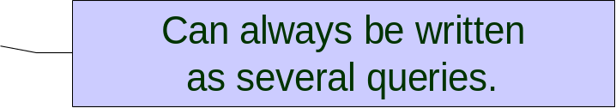
Subqueries in HQL
Correlated subquery, total items sold by users, if more than 10:
Uncorrelated subquery, all bids that are 1 within the maximum:
We can use SQL quantifiers, ANY/ALL/SOME/IN:
from User user where 10 < (
select count(item) from user.items where item.successfulBid is not null
)
from Bid bid where bid.amount + 1 >= (
select max(b.amount) from Bid b
)
from Item item where 100 > all ( select b.amount from item.bids b )
from Item item where 100 < any ( select b.amount from item.bids b )
from Item item where 100 = some ( select b.amount from item.bids b )
from Item item where 100 in ( select b.amount from item.bids b )

